Slide 1



Vue.js 3 for Beginners
Anass BOUTAKAOUA
Senior Frontend Developer

Slide 2
Agenda
Introduction to Vue.js
Setting Up the Development Environment
Rendering Data and Handling Events
Reactivity API
Understanding the Vue Instance
Understanding Vue components
Communication between components
Routing with Vue Router
State Management
Project 1 - Todo List Application
Project 2 - Mini E-commerce Application
Q&A Session

Slide 3
Introduction to Vue.js
What is Vue.js?
A progressive JavaScript framework for building modern user interfaces.
Designed to be incrementally adoptable.
Emphasizes simplicity and flexibility.

Slide 4
Introduction to Vue.js (2)
Why choose Vue.js for Frontend Development?
Lightweight and easy to integrate.
Versatile: scales from simple to complex applications.
Large and active community for support and collaboration.

Slide 5
Introduction to Vue.js (3)
Vue.js Features
Reactive Data Binding
Component-Based Architecture
Virtual DOM for Efficient Rendering

Slide 6
Setting Up the Development Environment
Requirements
IDE
Node.js
NPM or Yarn

Slide 7
Setting Up the Development Environment (2)
Creating project using Vue CLI
yarn global add @vue/cli
vue create hello-world

Slide 8

Setting Up the Development Environment

Slide 9
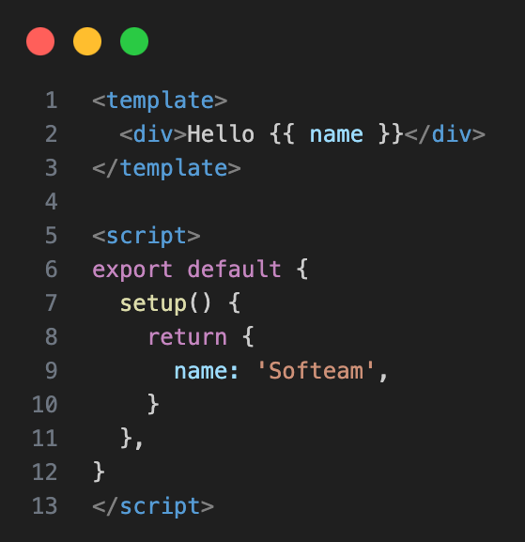
Rendering Data and Handling Events
Displaying Text
To display text, we use interpolation. Interpolation refers to embedding expressions into marked-up text.
Interpolation uses the double curly braces {{ and }} as delimiters.
Alternatively, you can utilize: v-text="model"
Interpolation

Slide 10
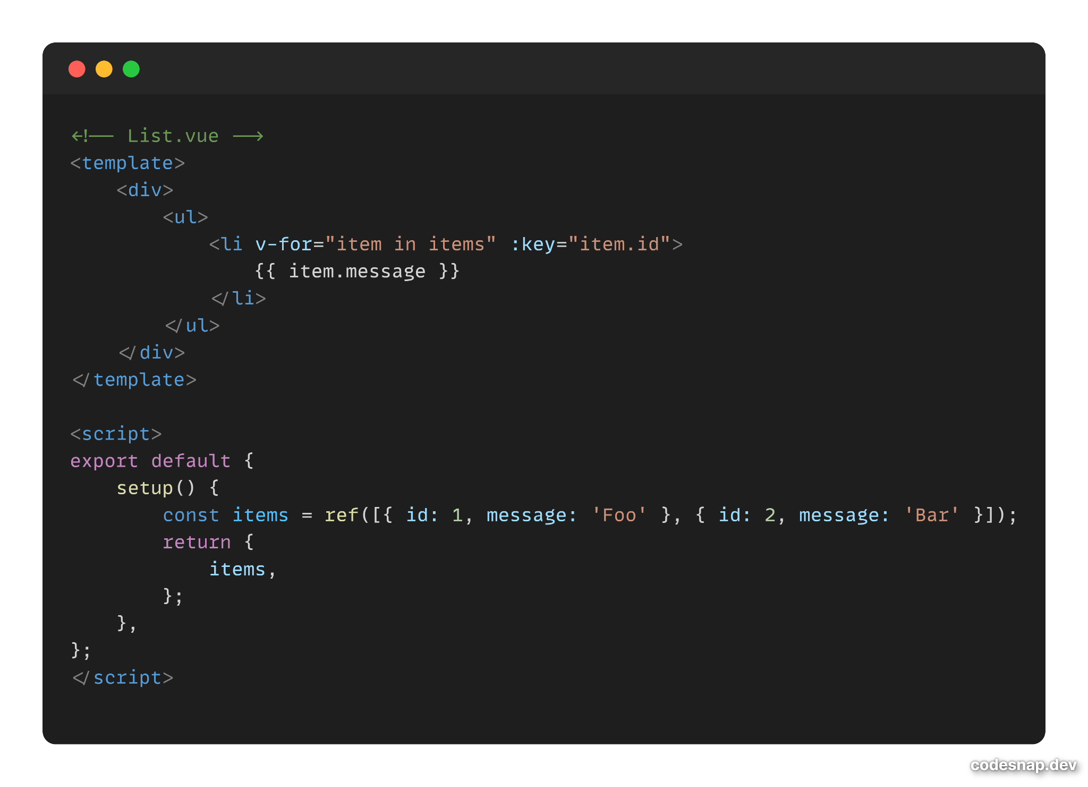
Rendering Data and Handling Events
List Rendering
To render lists in Vue.js, use the v-for directive to loop through an array or an object and pass the data to a component. Use the :key attribute to optimize the rendering.

Slide 11
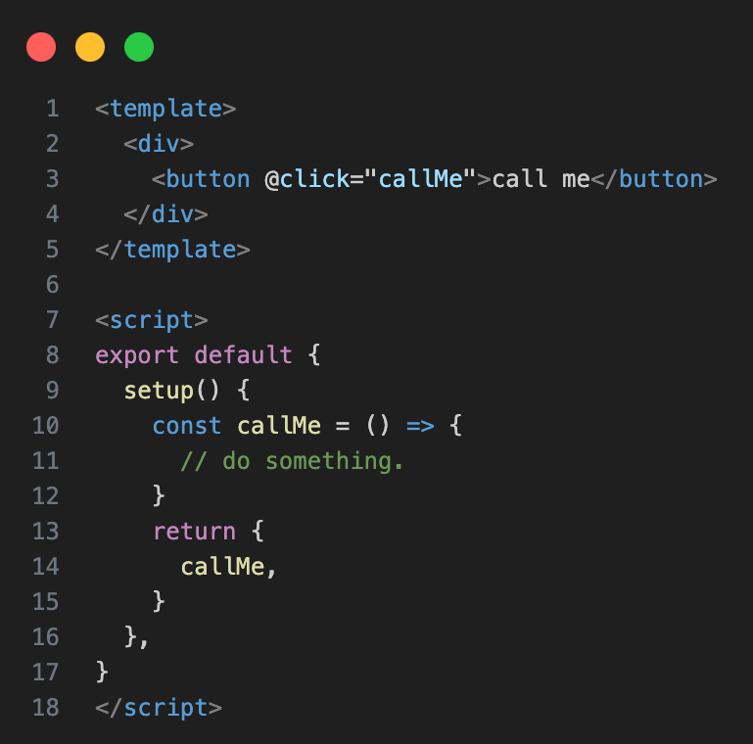
Rendering Data and Handling Events
Event binding
Binding events allows you to observe and react to user actions, including keystrokes, mouse movements, clicks, and touches.

Slide 12
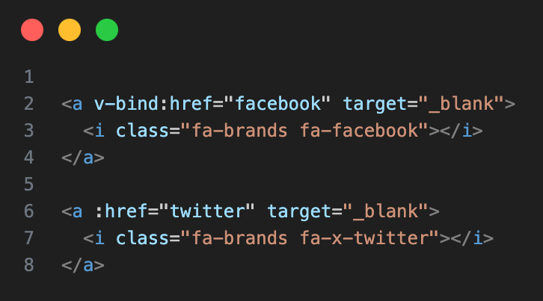
Rendering Data and Handling Events
Property binding (Bind to an HTML attribute)
Full v-bind syntax
Shortcut syntax

Slide 13
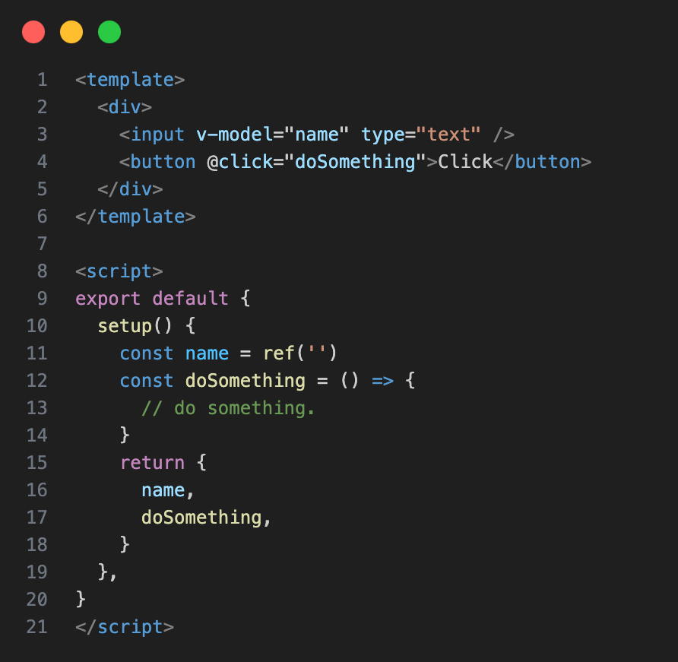
Rendering Data and Handling Events
Two-way binding
Provides a mechanism for components to share data, enabling the simultaneous listening for events and updating of values between parent and child components.

Slide 14
Rendering Data and Handling Events

Slide 15
Reactivity API
Introduction
The Reactivity API in Vue serves a crucial role in simplifying the management of state and ensuring dynamic updates in response to changes.
It provides developers with a structured and efficient way to handle reactivity in their applications.

Slide 16
Reactivity API
Basic reactivity functions
reactive()
ref()
computed()

Slide 17

Reactivity API
Function | Purpose | Reactivity | Requires .value?
reactive | Creates a reactive object from an existing object. | Changes to properties within the object trigger reactivity.
ref | Creates a reactive reference to a value. | Changes to the `ref` value itself or primitive values trigger reactivity.
computed | Creates a computed property based on reactive deps. | Automatically tracks dependencies, re-evaluating on dependency changes.

Slide 18
Reactivity API

Slide 19
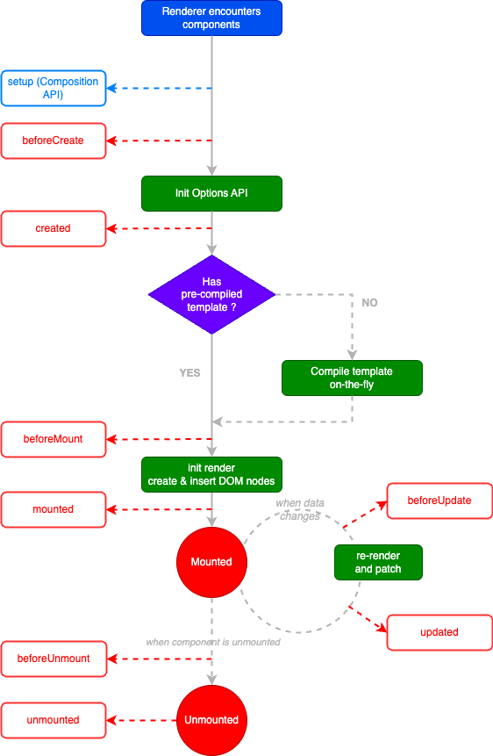
Understanding the Vue Instance

Slide 20
Understanding the Vue Instance
Composition API vs Option API
Composition API: Organizes logic by feature, enhances readability, encourages reusable functions, and provides better TypeScript support. Allows for dynamic imports, making it more tree-shakable.
Options API: Organizes logic by lifecycle, may become verbose, and has limited reusability relying on mixins. Access to the component is indirect, and tree-shakability can be compromised.

Slide 21
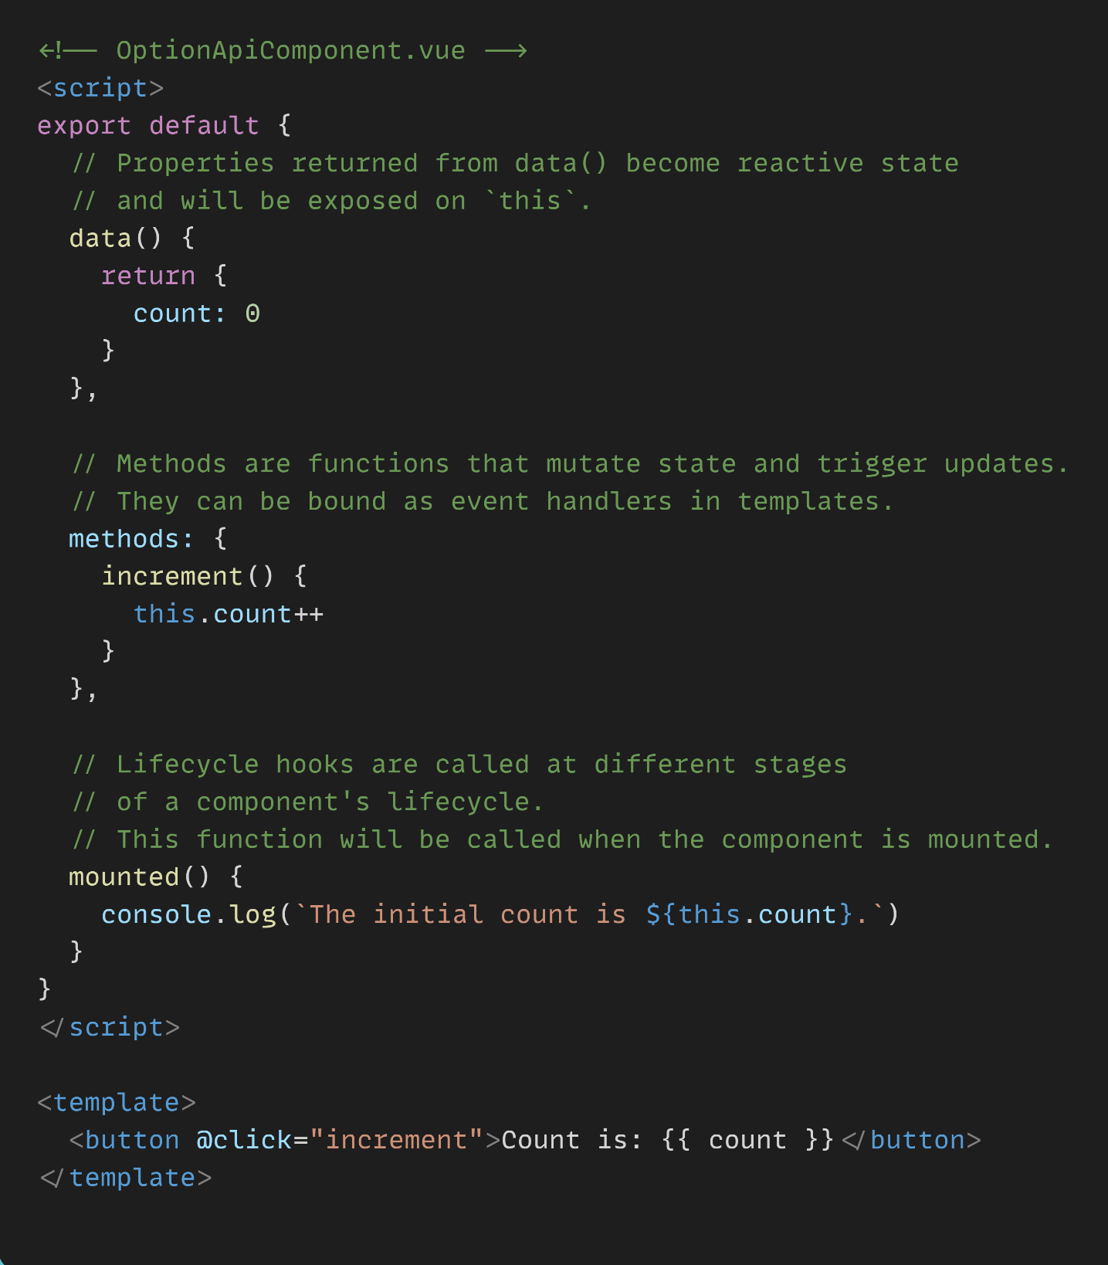
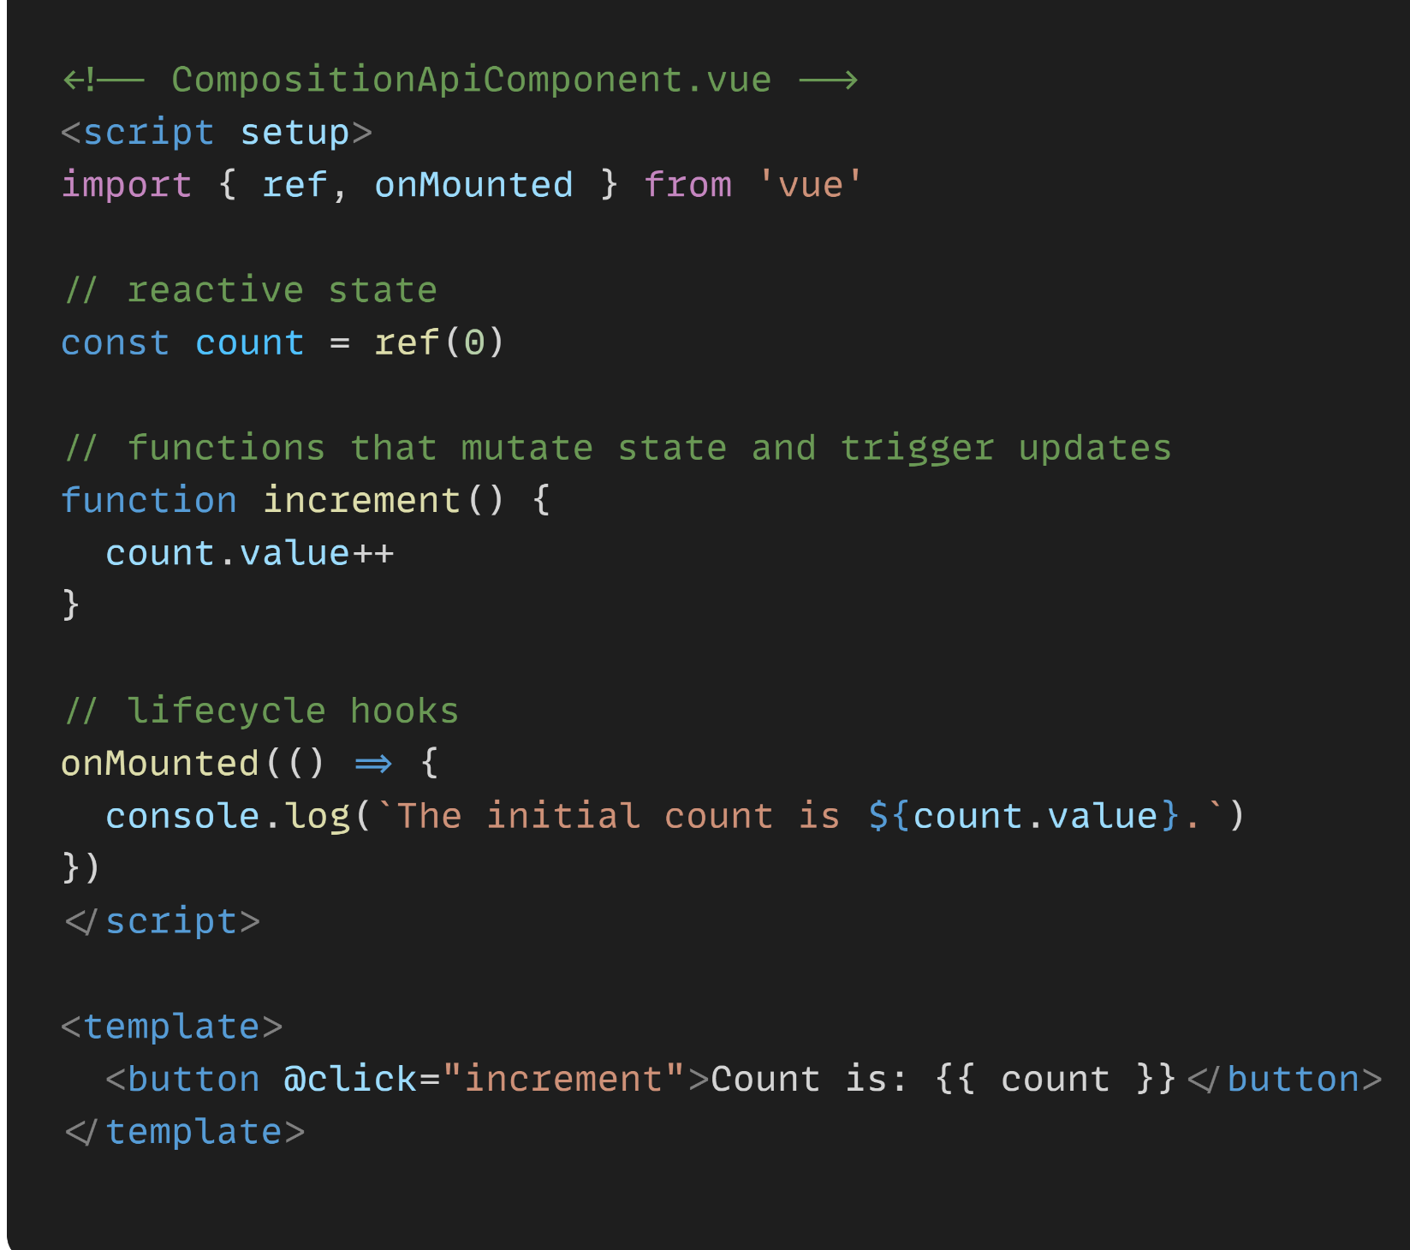

Slide 22
Understanding Vue components
What’s a component ?
Components serve as the fundamental building blocks for applications. Each component encompasses:
An HTML template specifying the page's rendering.
A JavaScript/TypeScript class defining its behavior.
A CSS selector determining its usage in a template.
Optionally, CSS styles applied to the template.

Slide 23
Understanding Vue components
Global component
Scope: Registered globally, meaning they are available throughout the entire Vue application.
Registration: Typically registered in the main entry file (main.js) or using the Vue.component method.
Usage: Can be used in any component or template without the need for explicit local registration.

Slide 24
Understanding Vue components
Local component
Scope: Registered locally within a specific component, limiting their availability to that component and its children.
Registration: Done within the components option of a Vue component.
Usage: Only accessible within the component where they are registered or its child components.

Slide 25
Understanding Vue components
Creating a component
To create a component in Vue.js, one commonly used approach is employing Single File Components (SFC). This method allows the organization of the template, script, and styles within a single file.
Create a new Vue component file:
Create a new file, for example, MyComponent.vue.
Define the component:
Inside MyComponent.vue, define your component using the <template>, <script>, and <style> blocks.

Slide 26
Understanding Vue components

Slide 27
Communication between components
Introduction
Communication between components is a crucial aspect of building dynamic and interactive applications. Components, as modular units, often need to share data, trigger actions, or synchronize their state.

Slide 28
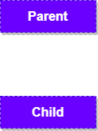
Communication between components
Parent to Child - Using properties (props)
Components can communicate by passing data from parent to child components through props, allowing for a unidirectional flow of information.

Slide 29
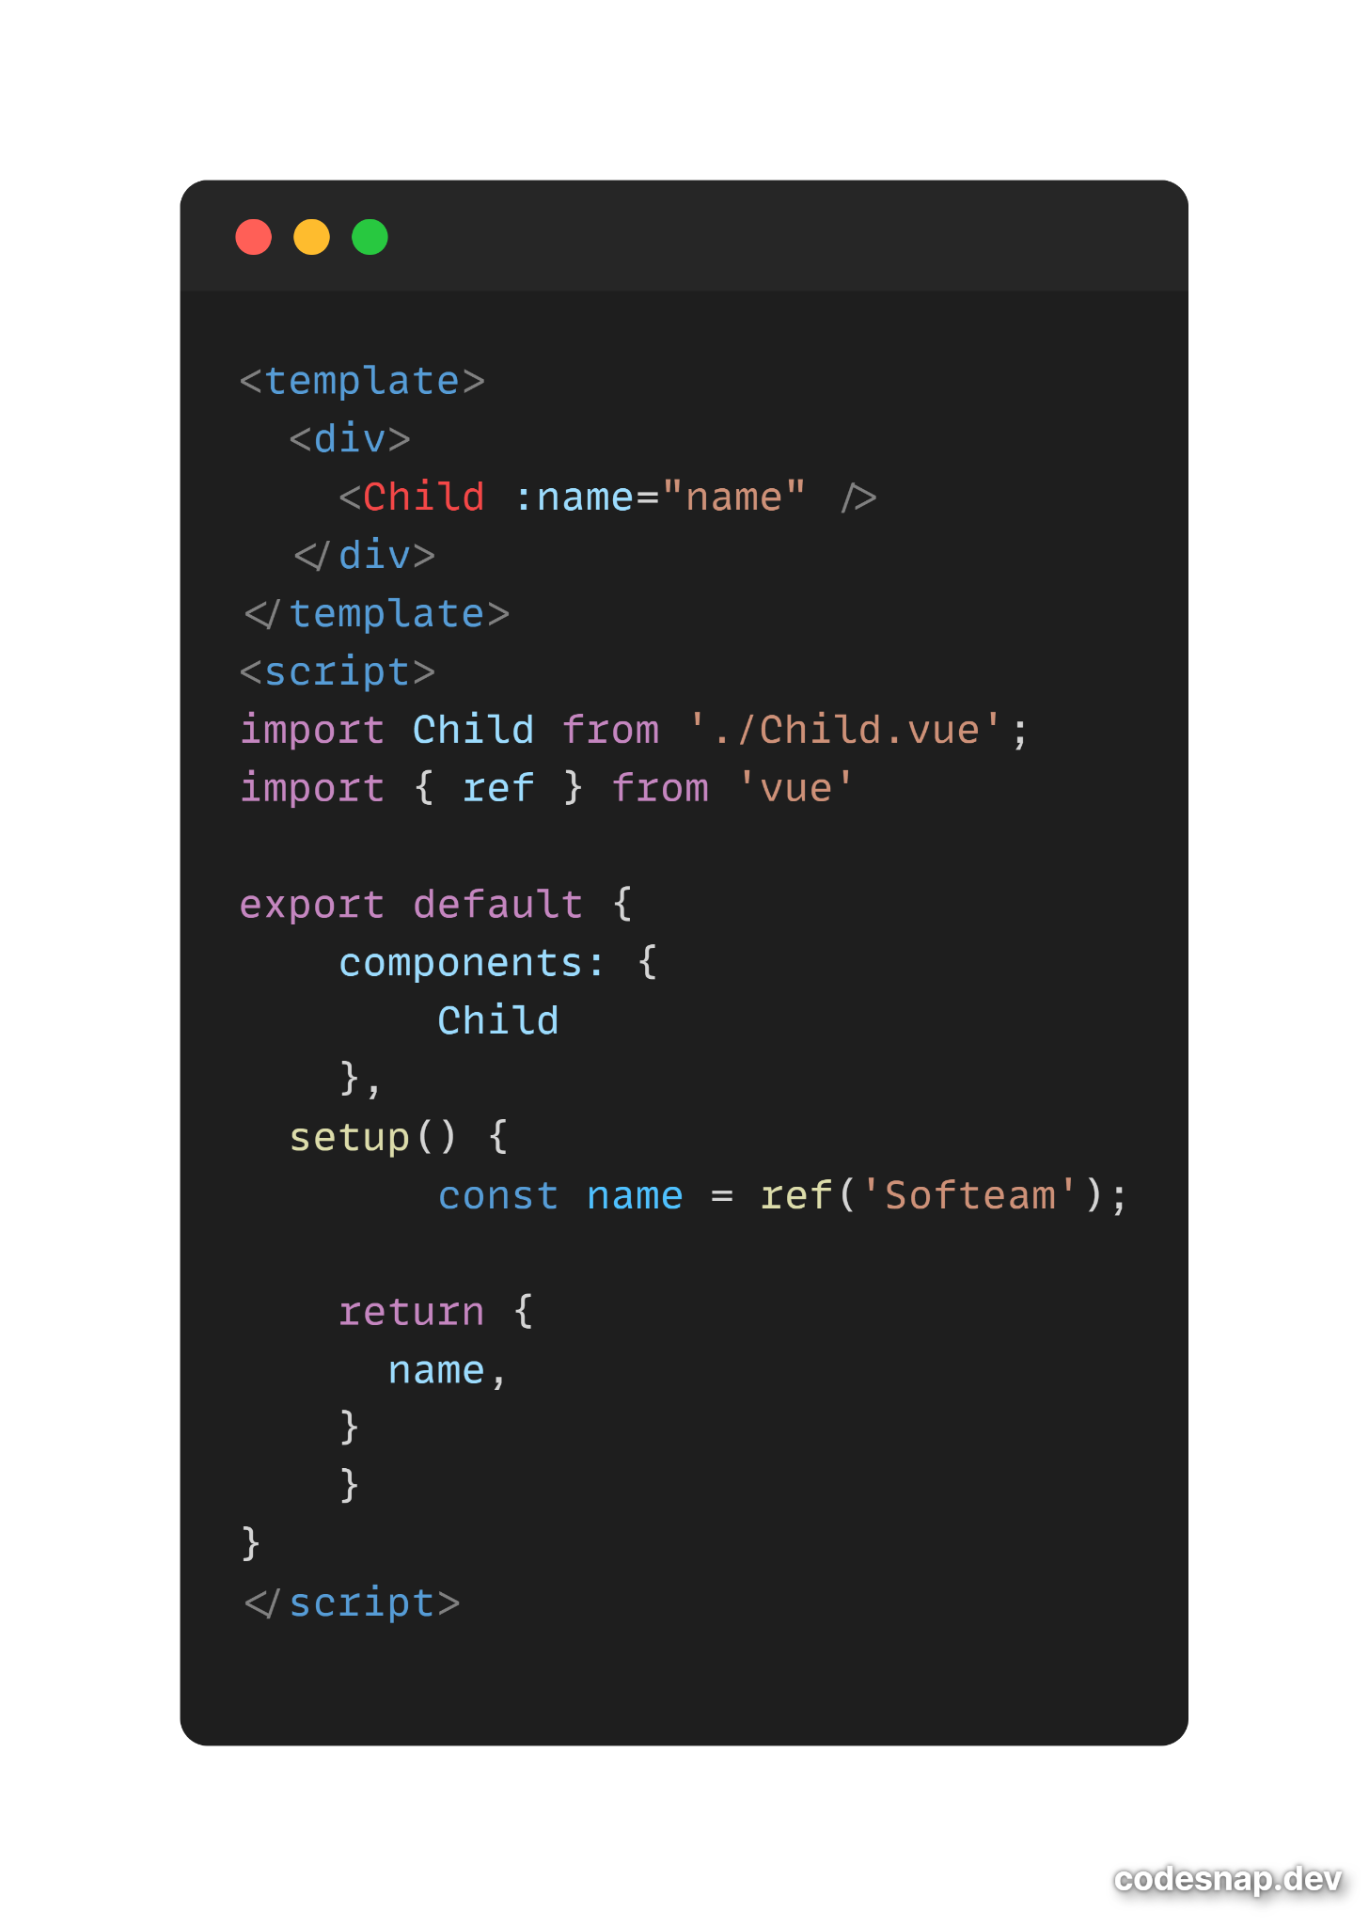
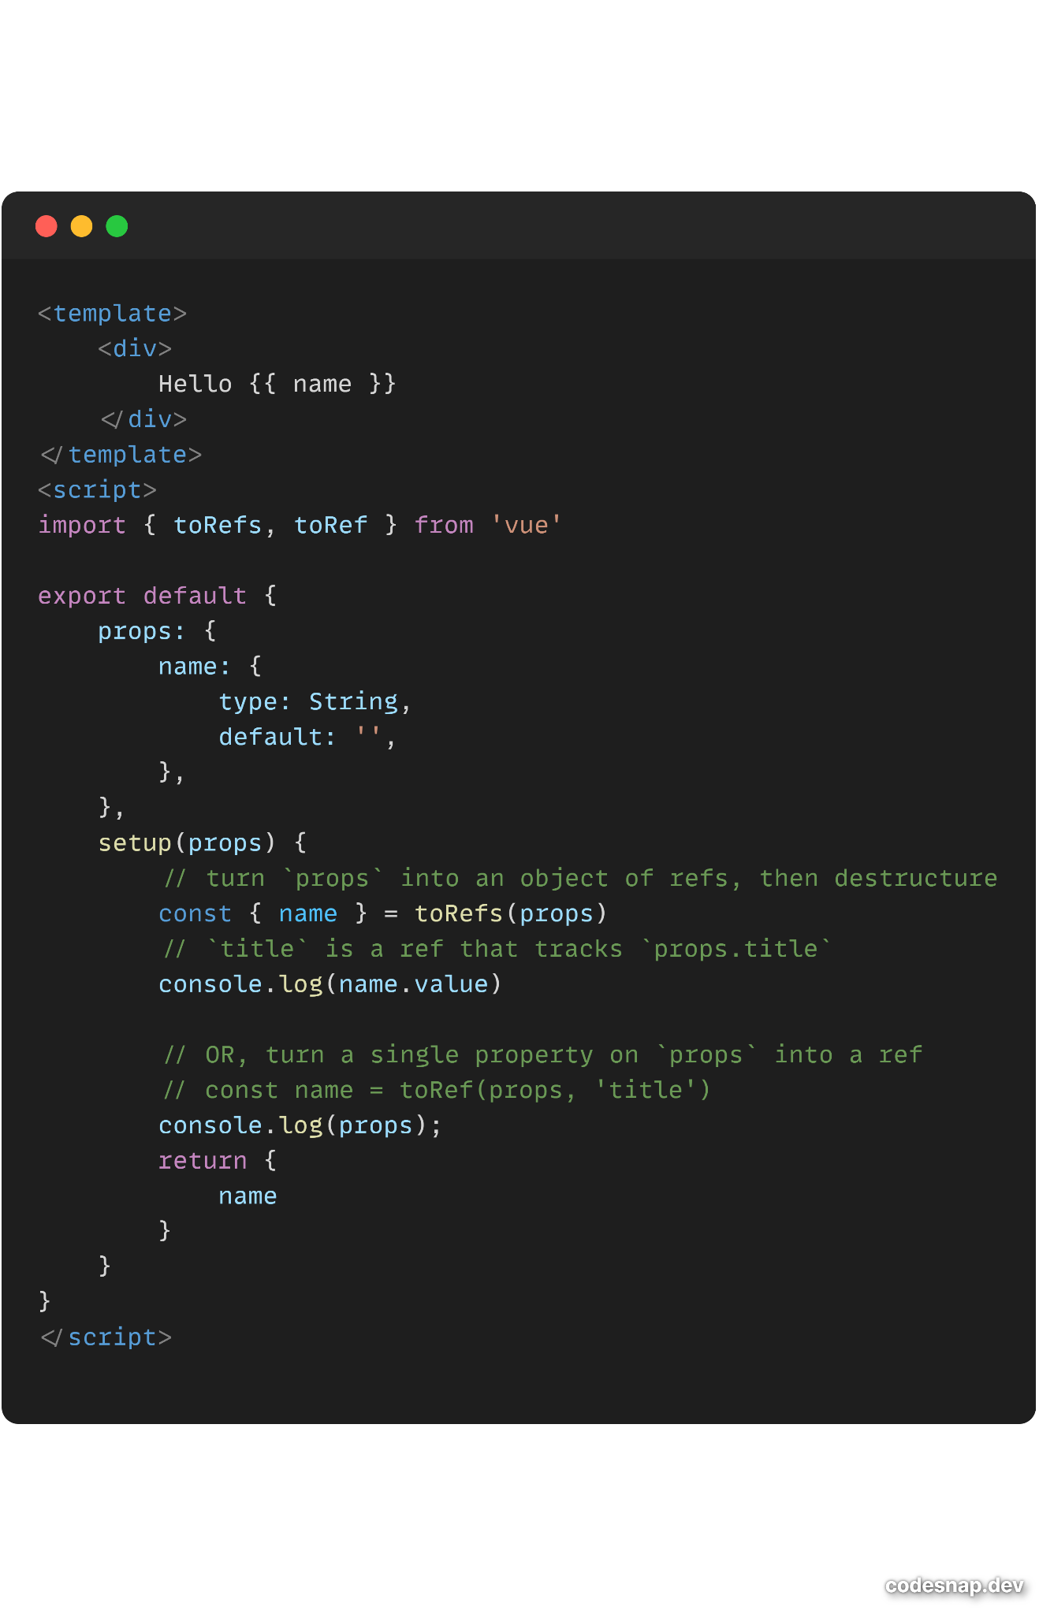
Parent
Child

Slide 30
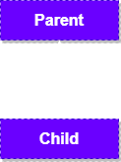
Communication between components
Child to Parent - Using custom events
Child components can emit custom events that are then listened to and handled by their parent components, enabling bidirectional communication.

Slide 31
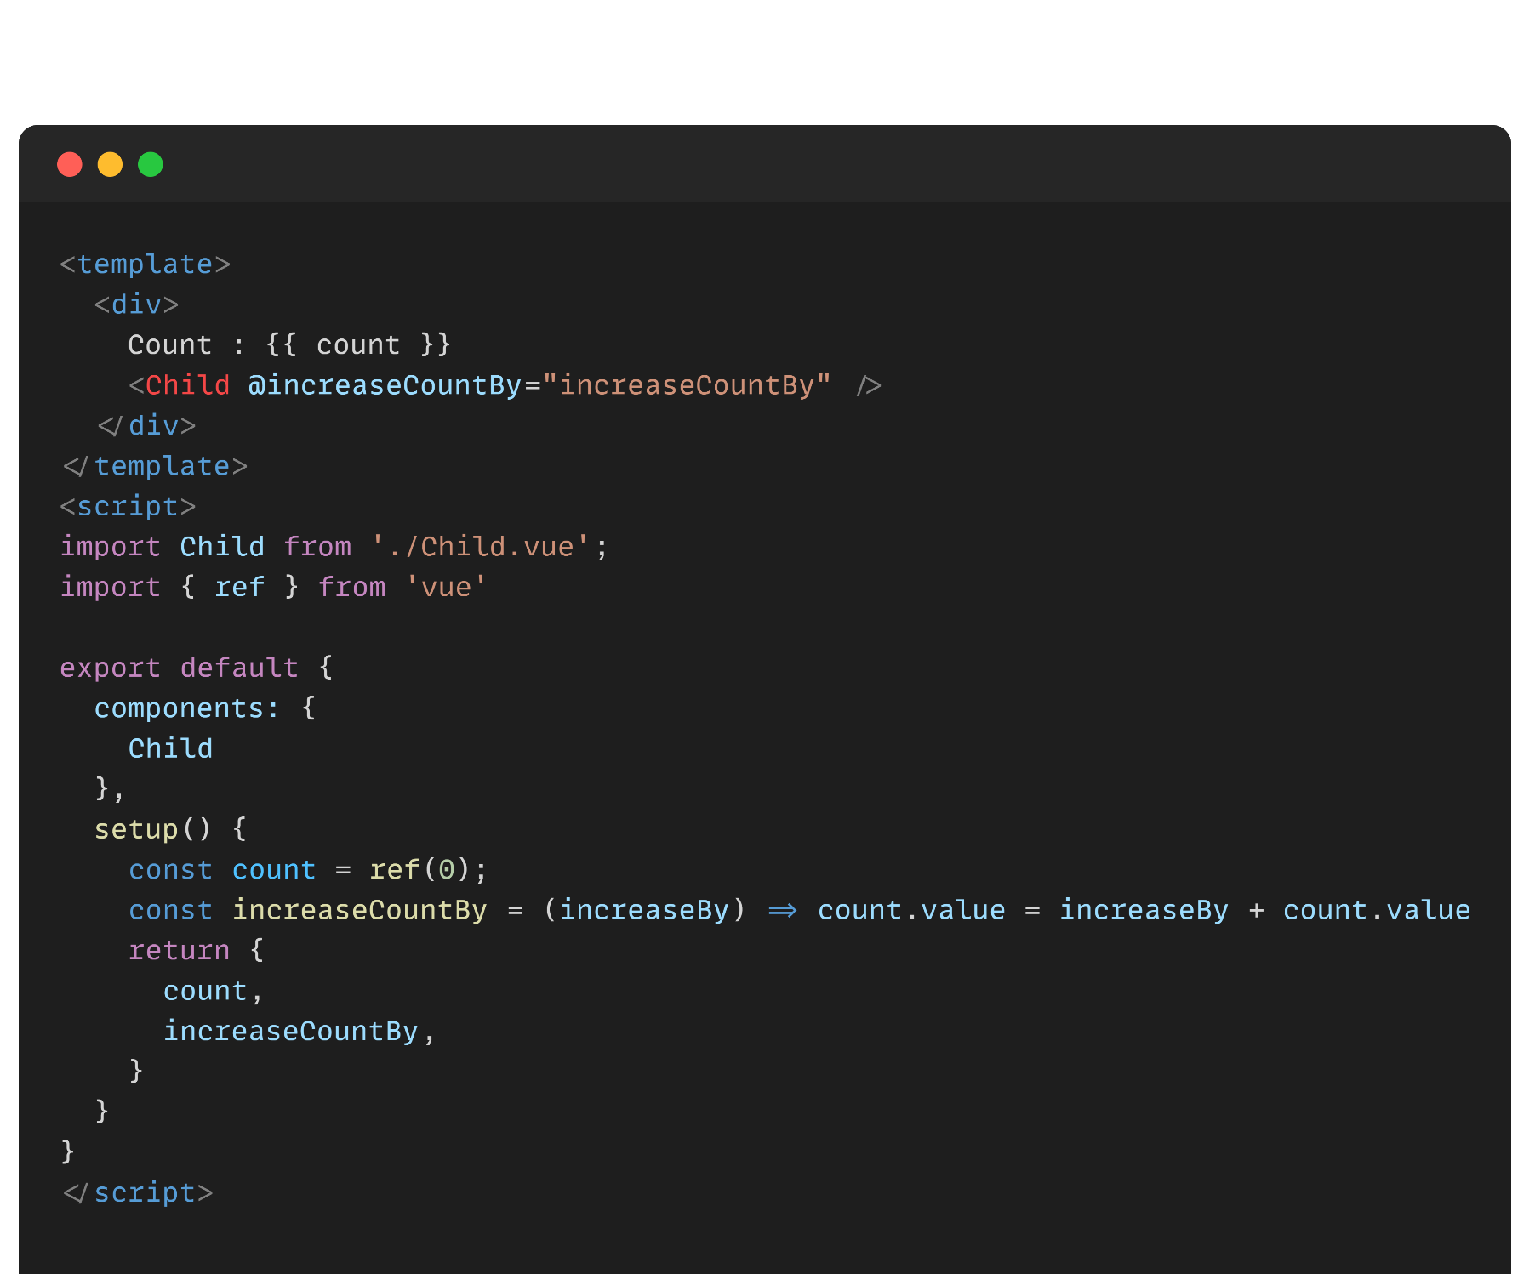
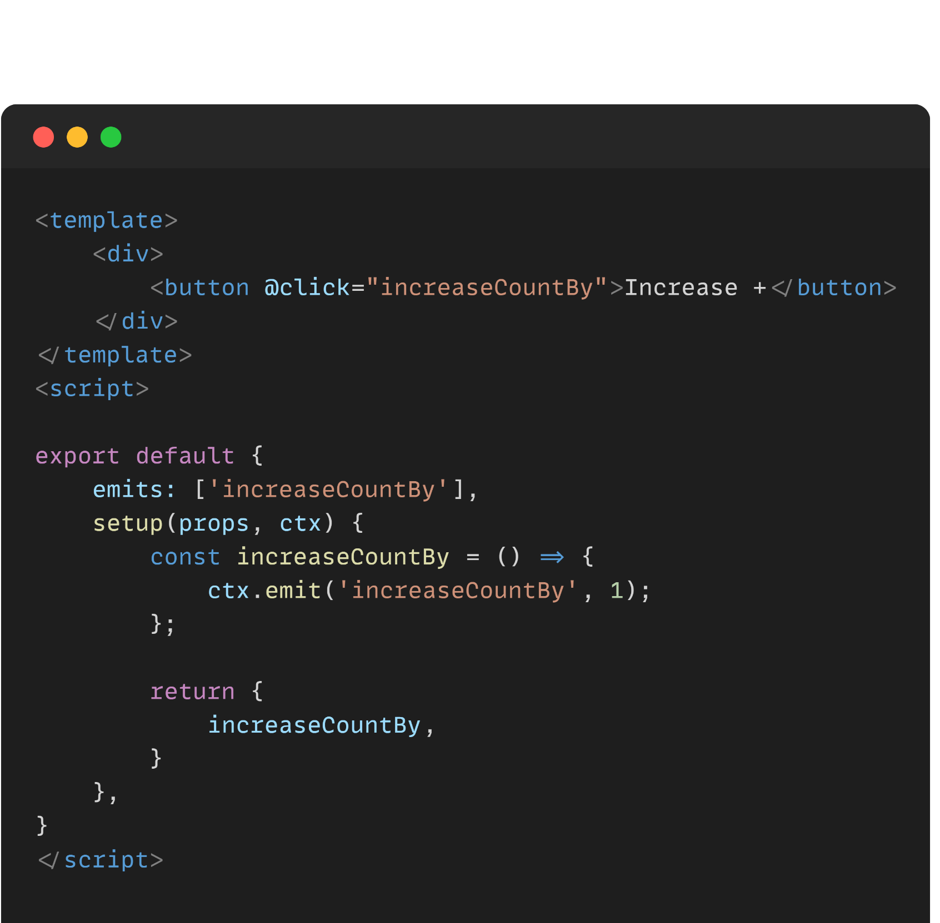
Parent
Child

Slide 32
Routing with Vue Router
Introduction
Vue Router, a cornerstone for Vue.js applications, empowers seamless navigation and enhanced user experiences in single-page applications (SPAs).

Slide 33
Routing with Vue Router
Installation
Install Vue Router using npm or yarn:
npm install vue-router
# or
yarn add vue-router

Slide 34
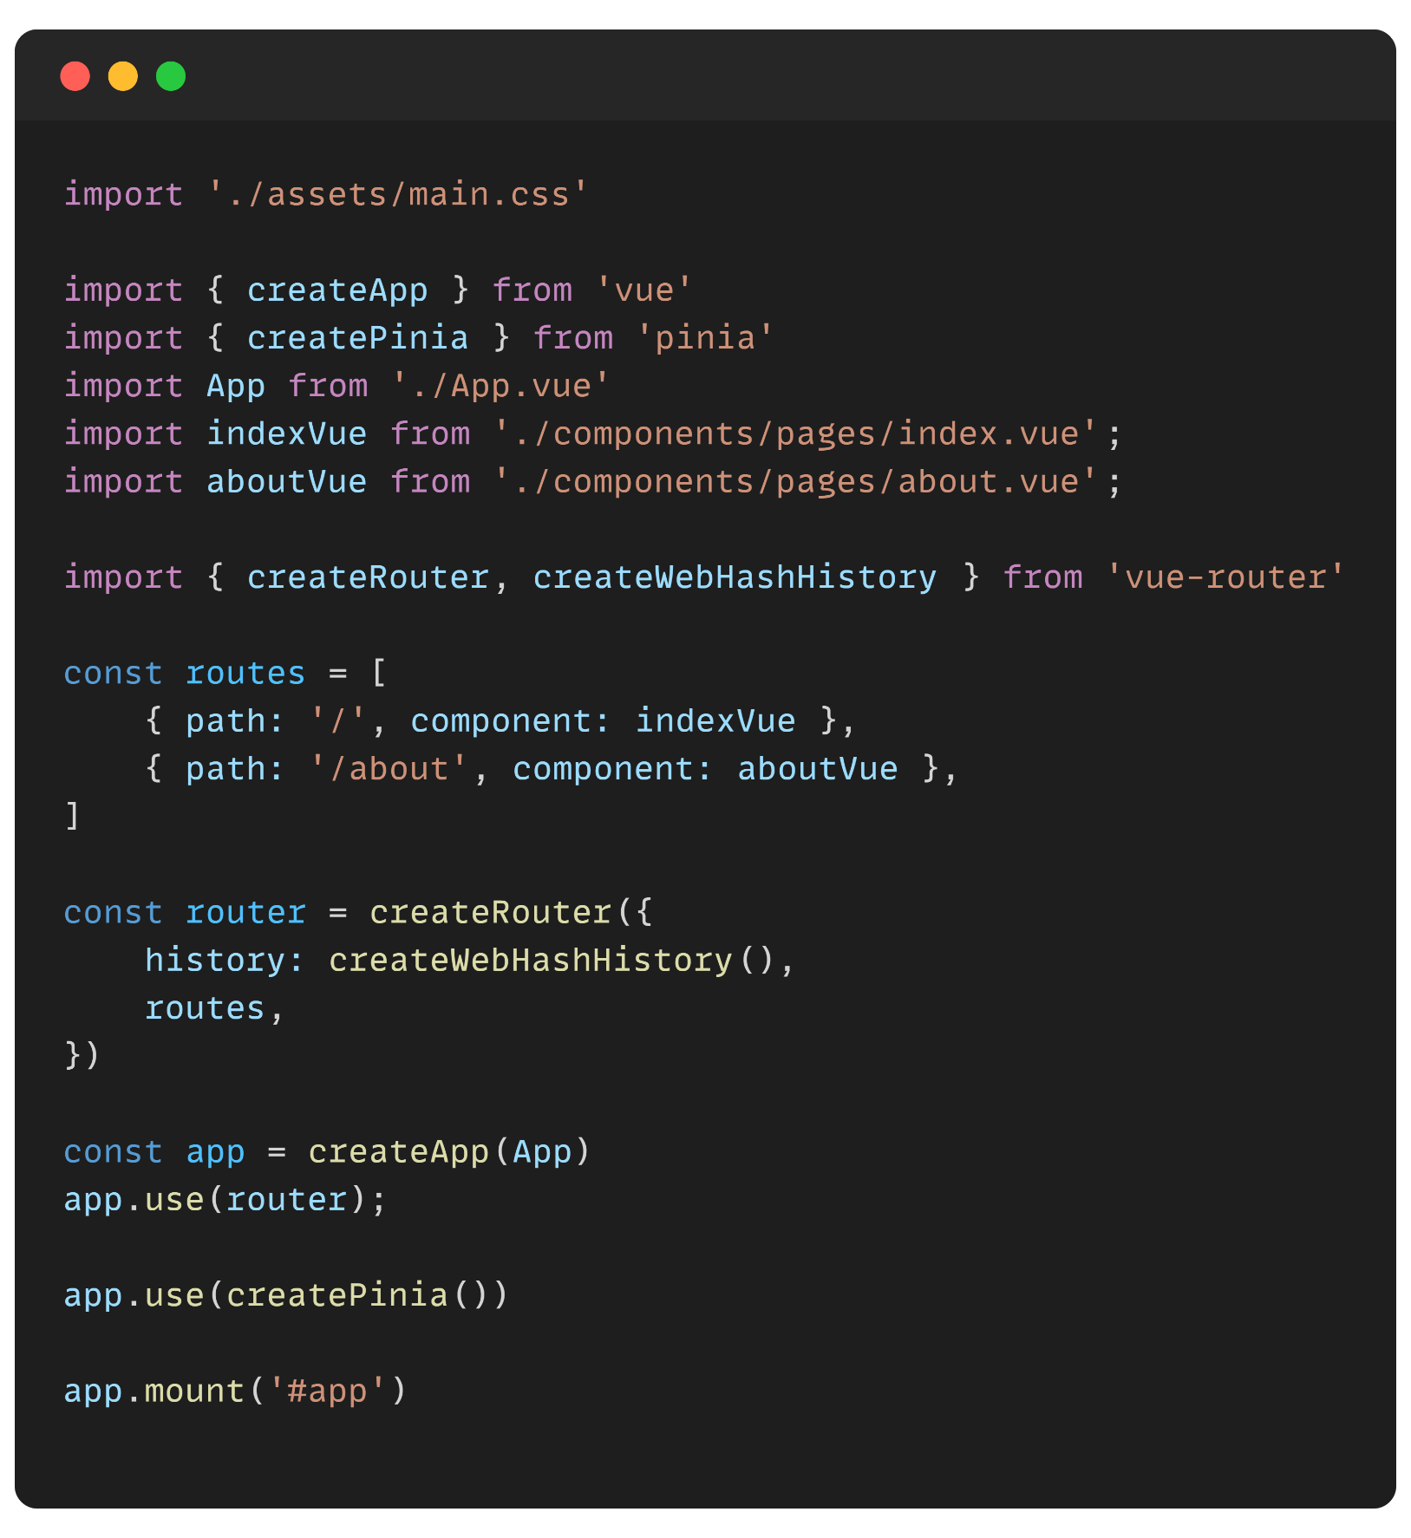
Routing with Vue Router
Creating a Router Instance:
Go to your main entry file (often main.js)
import { createRouter, createWebHashHistory } from 'vue-router'
Then create a router instance:

Slide 35
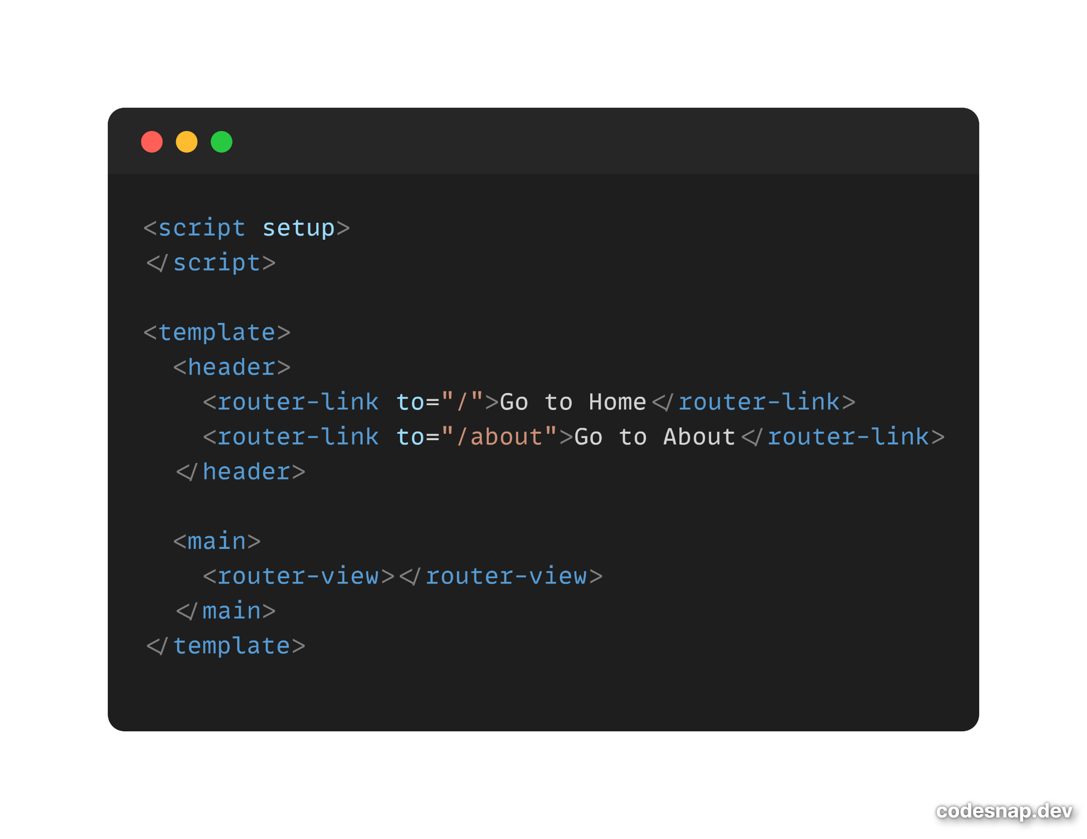
Routing with Vue Router
Integrating Router-View and Router-Link
<router-link> is a Vue Router component used to create navigation links, enabling seamless transitions between routes in a Vue.js application.
<router-view> dynamically renders Vue components based on the active route, facilitating seamless navigation in single-page applications.

Slide 36

State Management
Introduction
Pinia is a lightweight state management library tailored for Vue.js. With a simple and reactive store pattern, it offers efficient state management, featuring modules and devtools for scalability and organization in Vue.js applications.

Slide 37
State Management
What’s a state manager ?
A state manager is essential for centralizing and organizing an application's data, simplifying component logic, improving debugging, and optimizing performance.
It enhances reusability, facilitates communication between components, ensures consistency across views, and supports asynchronous operations, contributing to scalable and maintainable software.

Slide 38
State Management
Pinia vs Vuex
Feature | Vuex | Pinia
Vue.js Integration | Official and deeply integrated. | Developed as an alternative to Vuex. (Integrated officially in Vue 3)
Reactivity | Relies on Vue's reactivity system. | Utilizes the Composition API for fine-grained reactivity.
Modularity | Features modules for organizing state. | Default module-based architecture.
Developer Experience | Mature and extensively documented. | Simplified syntax and embraces the Composition API.
TypeScript Support | Good TypeScript support, requires additional declarations. | Built with TypeScript, seamless and type-safe integration.

Slide 39
State Management
Pinia vs Vuex (2)
Feature | Vuex | Pinia
Performance | Well-optimized and performs efficiently. | Emphasizes performance with built-in optimizations.
Namespacing | Supports namespacing for modularization. | Implements namespacing for avoiding naming conflicts.
Devtools Integration | Fully integrated with Vue Devtools. | Provides its own Devtools extension.
Community Adoption | Established and widely adopted. | Gaining popularity, particularly for Composition API users.

Slide 40
State Management
Installation of Pinia
npm install pinia
# or
yarn add pinia

Slide 41
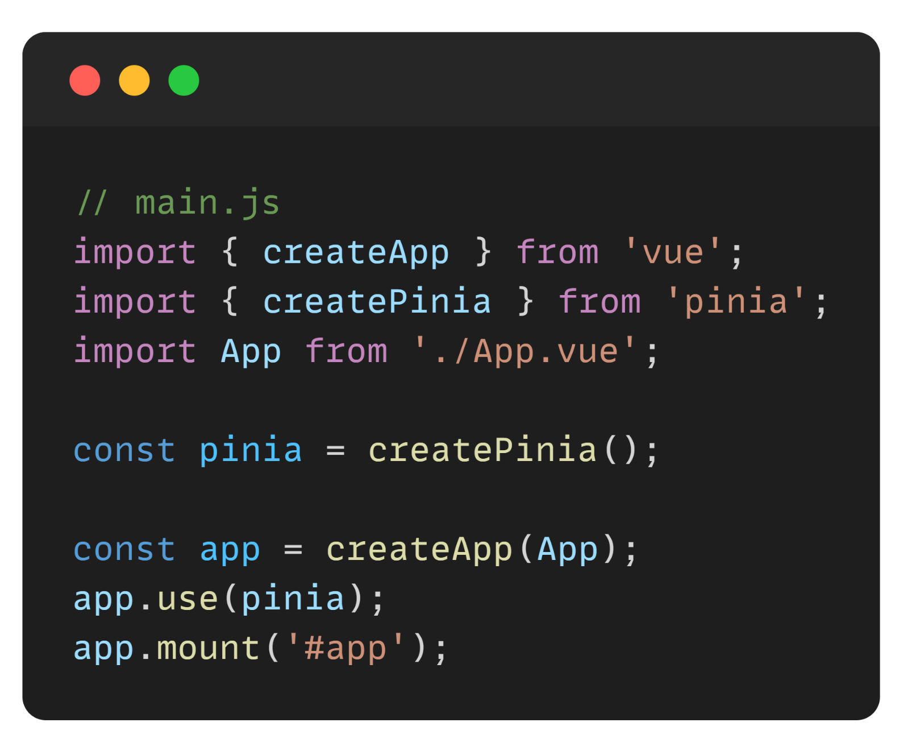
State Management
Setting up Pinia
In Vue 3 you will find pinia already integrated
In Case of Vue 2 or earlier you need to modify your main.js

Slide 42
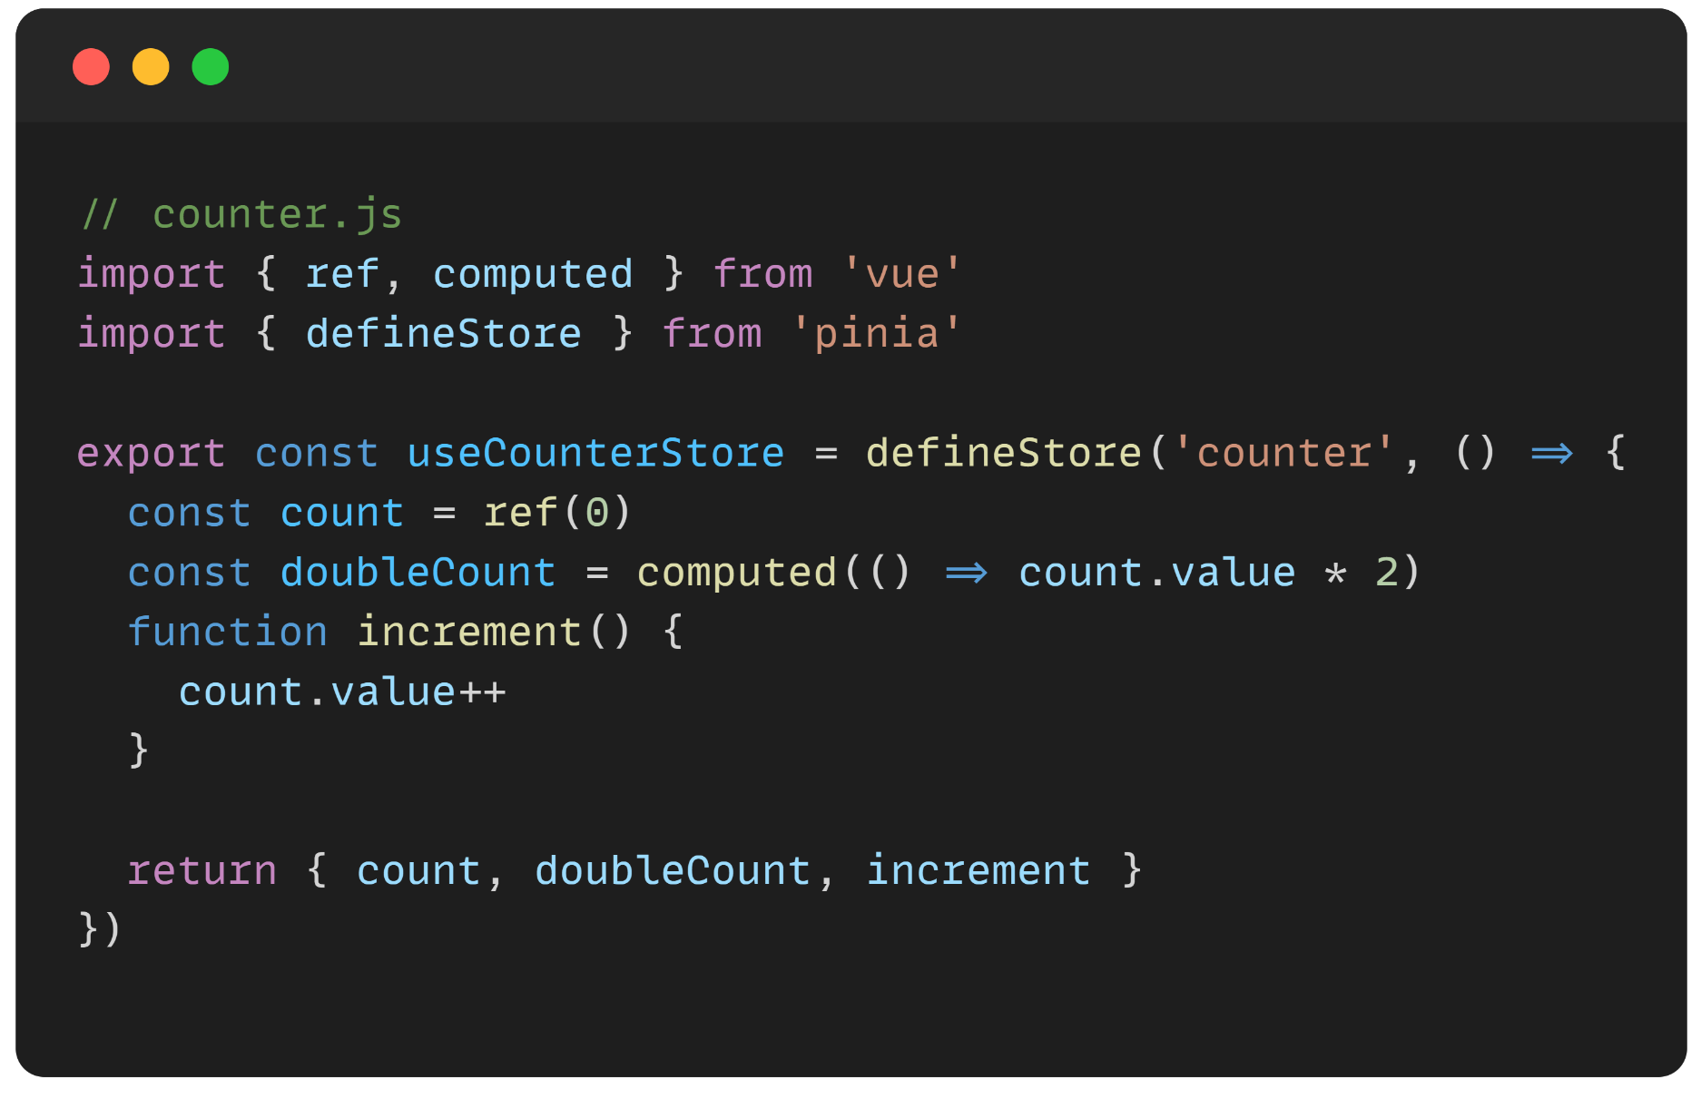
State Management
Configure State and Actions

Slide 43
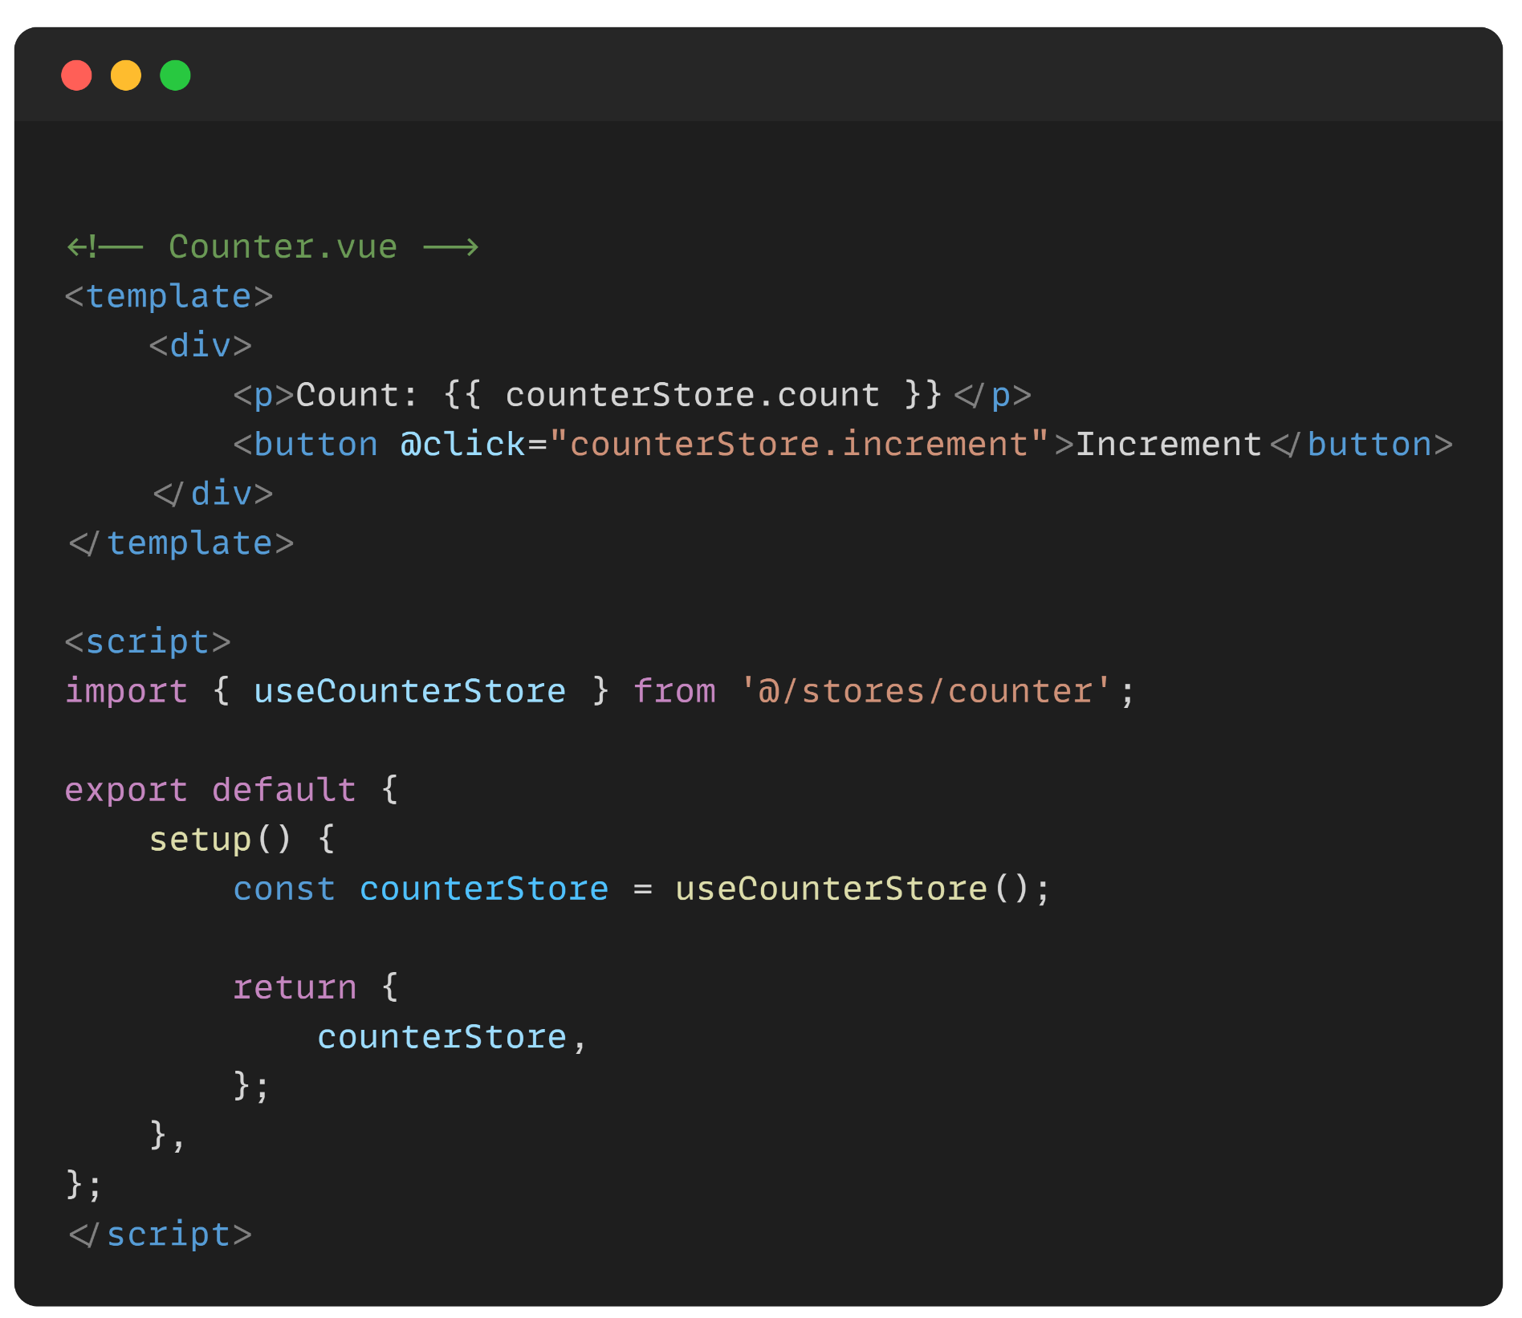
State Management
Configure State and Actions

Slide 44
State Management

Slide 45
Project 1 - Todo List

Slide 46
Project 2 - Mini E-commerce application

Slide 47

Q&A Session

